Slide 1

Weekly Report
Tianyu Wang
September 2,2021

Slide 2
Review of Last Meeting
Completed:
Topic modeling on commit message, code comment and pull request
To do:
Find the optimal topic number

Slide 3

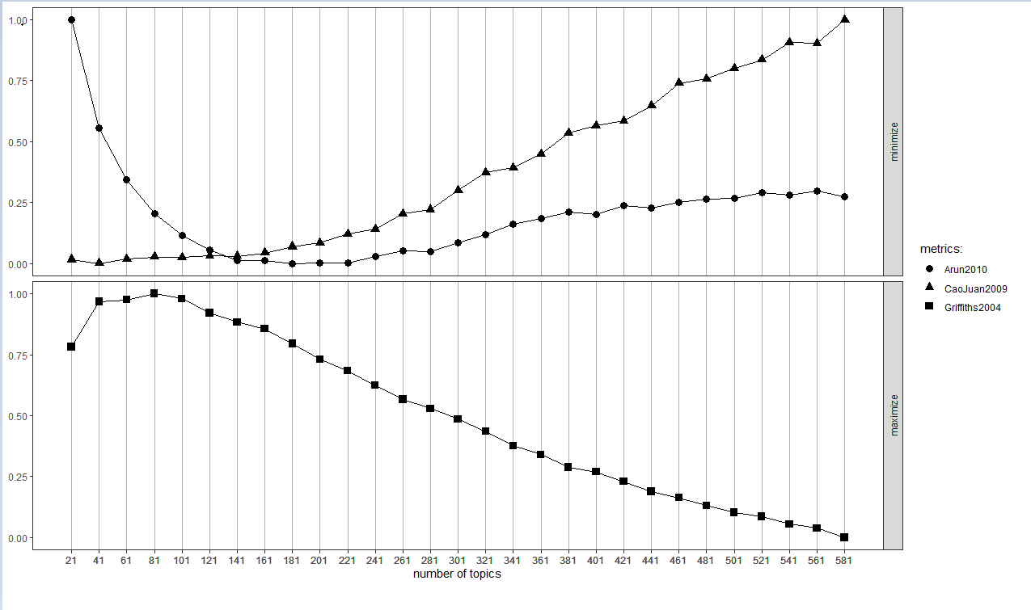
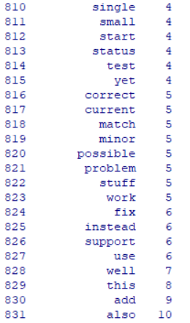
Topic words for commit message
"Arun2010", "CaoJuan2009", "Griffiths2004 ", " Deveaud2014 "

Slide 4
Optimal topic number is 62
Each topic has 20 topic words
46 topic words appear twice

Slide 5
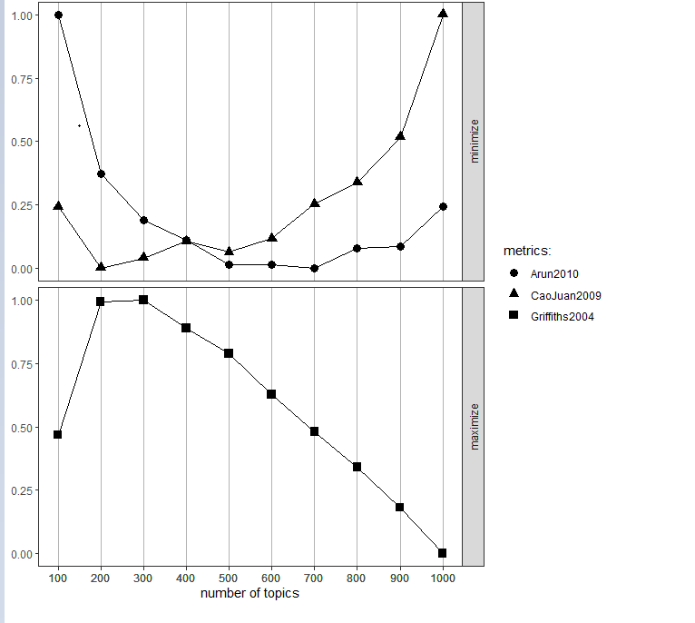
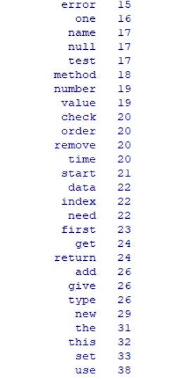
Topic words for code comment

Slide 7
Next Step
1. Summarize the topic.

